Slide 1
Goal of infrastructure development is enhancing the standard of living of people and bring happiness

Slide 2
Infra Advisors enables exploration and investment in infrastructure opportunities in India
Infra Advisors is PPP Expert & Finance Expert

Slide 3
Infra Advisors influences the infrastructure domain with its knowledge and experience enriched over a decade. Started in 2010 with a team of just two, today Infra Advisors is a 35+ professionals strong team offering services pan India and Internationally.
Extensive Experience, Deep Insight
Notes:
Recheck registered tag line – Braj to rework on tag line … in side the slide

Slide 4
Approach of Infra Advisors is unique to each client, ensuring our recommendations lead to sustainable investments while maintaining optimal risk levels for our clients.
Managing Complexity, Driving Simplicity

Slide 5
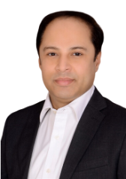
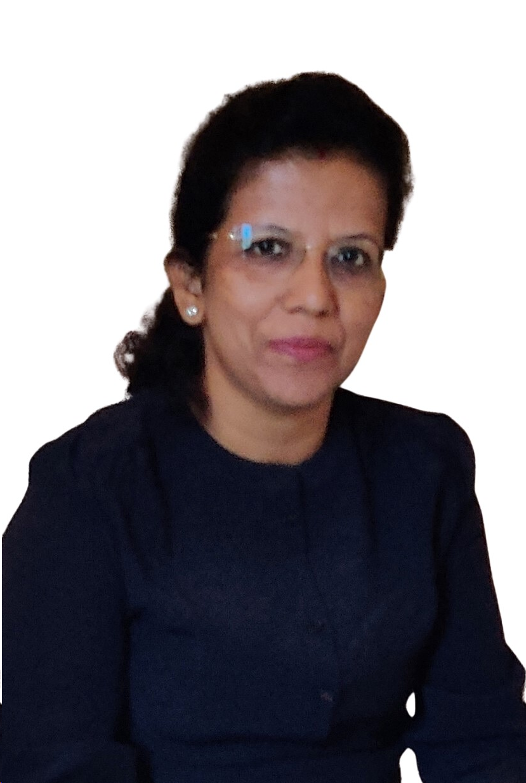
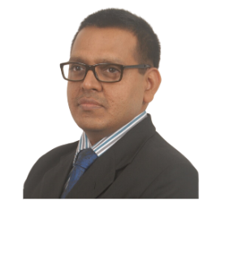
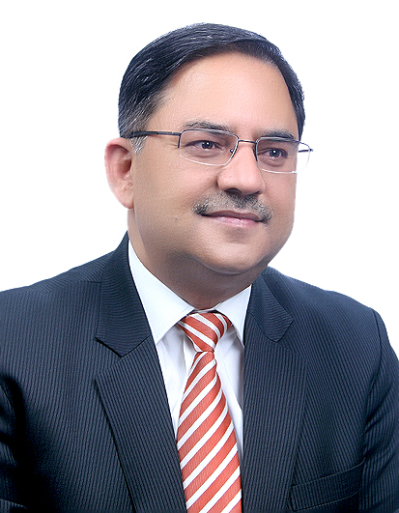
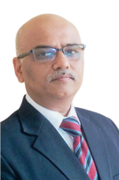
Infra Advisors Leadership Team
The Infra Advisors leadership team comprises of professionals having extensive experience and expertise in infrastructure project implementation, infrastructure finance, risk and credit management, banking and financial institutions.
Vipin Verma has more than two decades of experience in banking and financial services covering roles in underwriting, portfolio management, formation and implementation of credit risk policies, sales, credit and collections, as well as IT infrastructure, operations and compliance management.
Final
Vipin Verma
MBA with 27 years of experience in BFSI and consultancy
Sunita Sethia
Chartered Accountant with 30 years of experience in auditing, finance and accounts, and consultancy
Praveen Sethia
Chartered Accountant and Cost Accountant with 30 years of experience in BFSI, Infra Projects, and consultancy
Chander Prakash Bhardwaj
Cost Accountant with 30 years of experience in BFSI, and consultancy
Anand Surange
BE and MBA with 30 years of experience in BFSI, and consultancy
"Leadership is the capacity to translate vision into reality" - Warren Bennis
Notes:
Rework

Slide 6
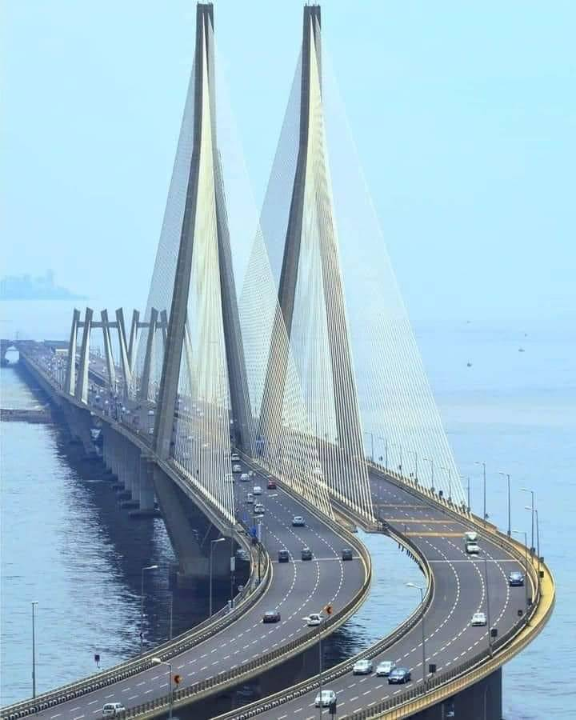

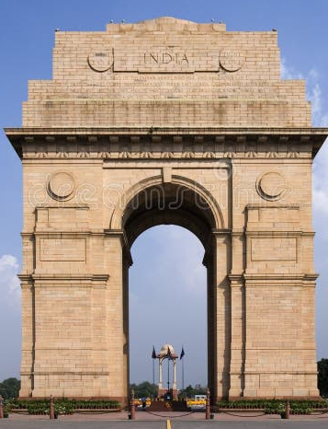


Infra Advisors Geo Footprint
Vipin Verma has more than two decades of experience in banking and financial services covering roles in underwriting, portfolio management, formation and implementation of credit risk policies, sales, credit and collections, as well as IT infrastructure, operations and compliance management.
Final
Mumbai
Hyderabad
Delhi
Jaipur
Kolkata
Notes:
Rework

Slide 7
Infra Advisors Business Trajectory
Ranked top 10 Financial Advisory for Asia Region by Dealogic for the 2ⁿᵈ time
Completed Financial Closure amounting to Rs. 7,000 Crore
Completed 1st Monetization Transaction for Road HAM Assets
2010
2015
2017
2022
2014
2016
2021
Laid the foundation for Infra Advisors
Achieved transaction advisory benchmark of Rs. 4,000 crores.
Recognized by Dealogic as top 10 transaction advisory in Asia Pacific
2ⁿᵈ in Global Advisors Rankings for Project Finance by Infralogic

Slide 8
Infra Advisors Growth
Started Government Advisory, empaneled with NHAI
Transaction Advisory in Real Estate
Started advisory into InvIT structure
2012
2014
2022
2010
2013
2020
2023
Laid foundation of Infra Advisors in Mumbai
Forayed into Coal MDO and Transmission
Forayed into multimodal transportation
Forayed into M&A Business

Slide 9
Infra Advisors Services bouquet

Slide 10
Infra Advisors Services
Business Advisory services specialize in supporting clients to navigate the complexities of the infrastructure sector.
Comprehensive analysis of the business dynamics, risk-reward matrix, and business opportunities create value for stakeholders.
Financial Modeling services include evaluating project or transaction specific opportunities.
Optimal solutions factor in underlying contract, taxation, accounting, trends, viability, bankability, and winnability.
Investment banking services facilitates Capital Raising for Infra projects at competitive cost, optimum non-recourse structure and in alignment with the concession agreement.
Infra Advisors have expertise in infra projects, financial markets, market trends, regulatory frameworks, and concession agreement constraints.
Business Advisory
Financial Modeling
Investment Banking

Slide 11
Infra Advisors Services
Our Monetization Services ensures higher realization, quick turnaround and optimum transaction deal structure.
Holding Infra Assets till maturity is counter productive for various reasons. Asset holding should be till the end of concession period, and then it should be divested.
Infra Advisors InvIT services support sponsors and assets owners from concept to implementation.
InvIT guidelines are complex even though provides opportunity to seek investment with strong governing structure and tax efficiency.
Infra Advisors scans opportunities, ensures alignment and support in evaluating, due diligence, negotiation, compliance, refinance and takeover.
The expansion of infra assets unlocks opportunities, including in distressed assets, whether financially or physically.
Assets Monetization
InvIT Advisory
Merger & Acquisition

Slide 12
Infra Advisors Competencies

Slide 13
Infra Advisors Competencies
Infra Advisors has grasp of infrastructure sector and tracks infrastructure action plans in different sectors.
Our proactive involvement and connect with the policymakers, ecosystem, enable us to stay informed about the various sectors, action plans, investment opportunities, as well as the practical aspects of implementing these projects and critical challenges.
Infra Advisors is having comprehensive understanding of the specific business dynamics of various sub-sectors of infrastructure. Sub-sectors include line Transportation (covering Roads, Railways, Waterways, and Aviation), Urban Infrastructure (encompassing Sewage Treatment Plants, Municipal Solid Waste management, and Metro systems), Renewable Energy, Mining, Transmission and more.
Infra Advisors' international accomplishments and following recognition underline its strong position in the Debt capital marketplace. Our proficiency in the Debt market enables us to efficiently secure Debt capital within timelines, at optimum cost, and attractive terms. Infra Advisors cover senior debt, subordinate debt, and structured debt, from various sources like Banks, Development Financial Institutions, IDF, and AIF.
Infra Sector Outlook
Sectoral Expertise
Debt Market Coverage

Slide 14
Infra Advisors Competencies
Stable policies and a proactive governance system have led to significant changes in the strategy for project asset development and holding. We monitor the evolving business dynamics, market trends, investment strategies of potential buyers, the perspective of regulatory authorities, and transaction terms. With our profound understanding, we assist our clients in accurately timing and valuing their assets during the monetization process.
Stable policies and a proactive governance system have led to significant changes in the strategy for project asset development and holding. We monitor the evolving business dynamics, market trends, investment strategies of potential buyers, the perspective of regulatory authorities, and transaction terms. With our profound understanding, we assist our clients in accurately timing and valuing their assets during the monetization process.
After the completion of a project, value generation typically relies on financial engineering. Infra Advisors' proficiency in the infrastructure sector empowers us to enhance value through an effective Financial Engineering, which is a blend of market insights, the strategic management of financial risks, and comprehensive simulation studies.
Stable policies and a proactive governance system have led to significant changes in the strategy for Project Asset development and holding. Infra Advisors monitors the evolving business dynamics, market trends, investment strategies of buyers, regulations, and transaction terms. Infra Advisors assists clients to take “time right” and “value right” decisions for assets monetization.
Infra Advisors’ understanding of the infrastructure sector empowers clients in achieving the right balance in Public-Private Partnership (PPP) ventures. Infra Advisors team factors in aspects like project viability, financial feasibility, bankability, accounting and financial treatment, taxation, and monetization opportunities. By integrating these elements, we deliver effective and successful solutions.
Financial Engineering
Infra Assets Business
Public Private Partnership

Slide 15
Infra Advisors Sectoral Coverage

Slide 16
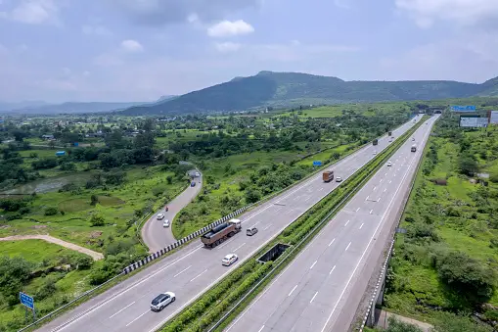

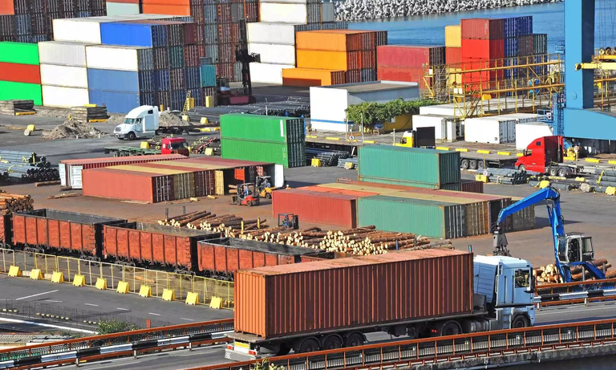

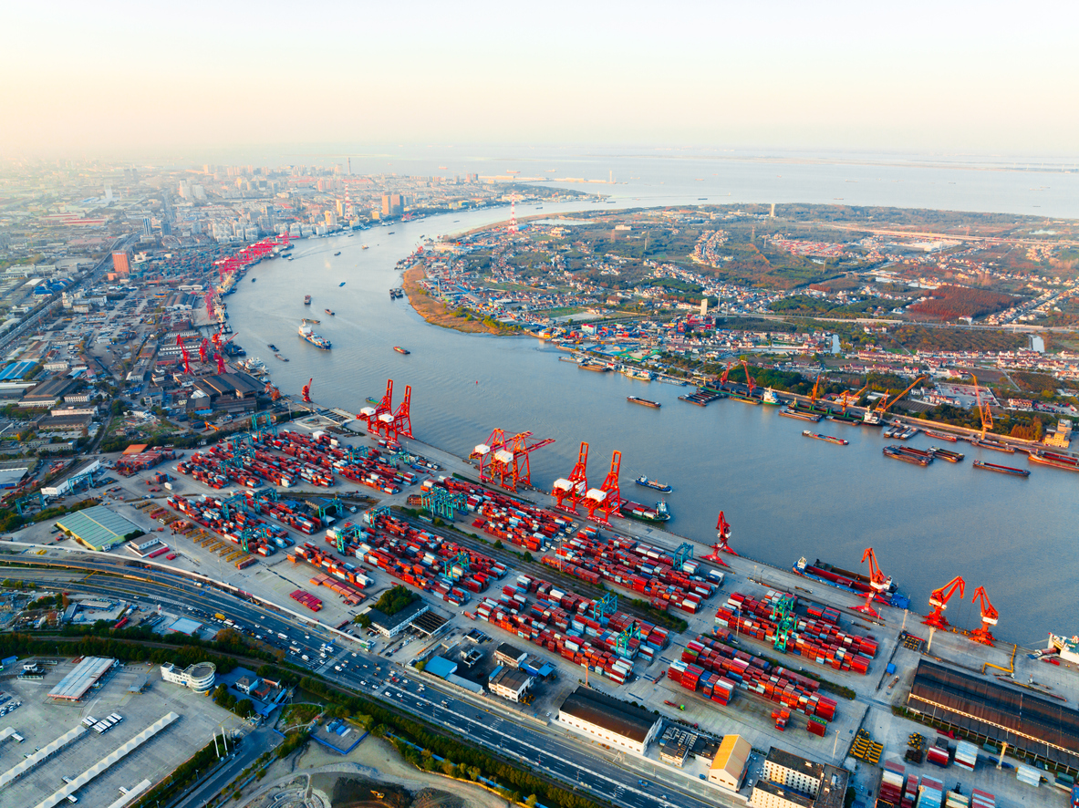
Infra Advisors Sector Coverage
Vipin Verma has more than two decades of experience in banking and financial services covering roles in underwriting, portfolio management, formation and implementation of credit risk policies, sales, credit and collections, as well as IT infrastructure, operations and compliance management.
Waste to Energy
Multi Modal Logistics Park
Roads
Smart Meter
Port

Slide 17





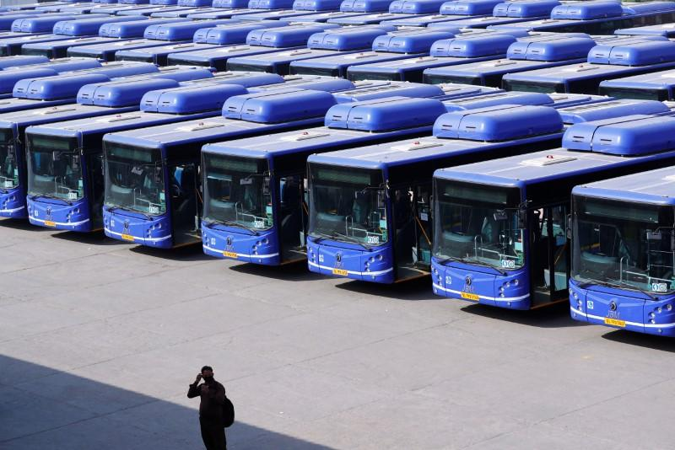
Infra Advisors Sector Coverage
Vipin Verma has more than two decades of experience in banking and financial services covering roles in underwriting, portfolio management, formation and implementation of credit risk policies, sales, credit and collections, as well as IT infrastructure, operations and compliance management.
Airport
Solar
E - Vehicles
Mine Operation and Development
Rope Ways

Slide 18
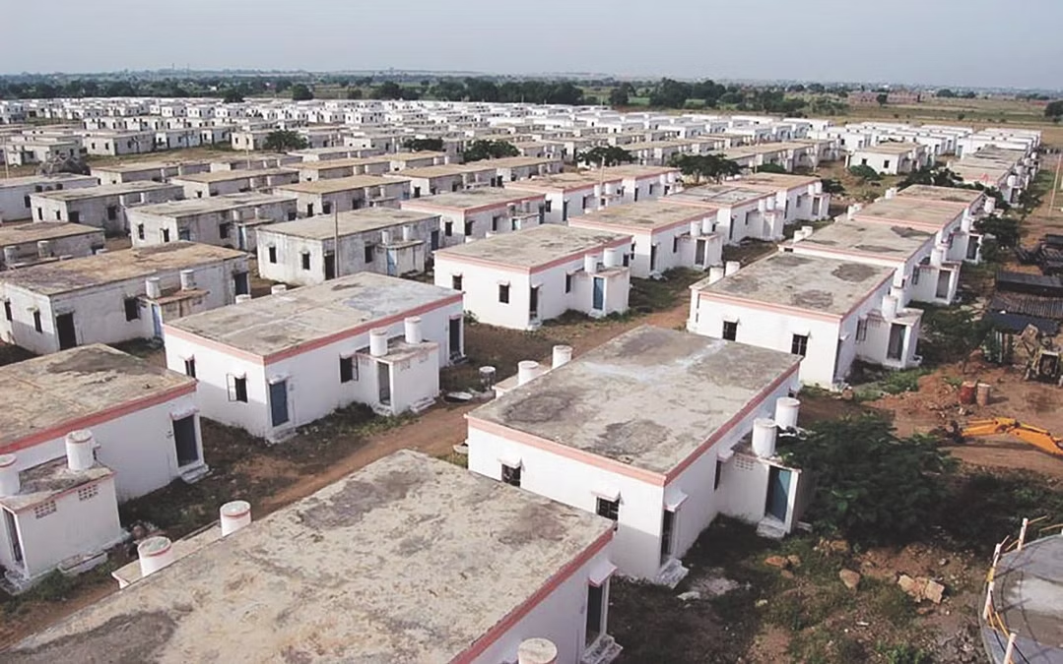
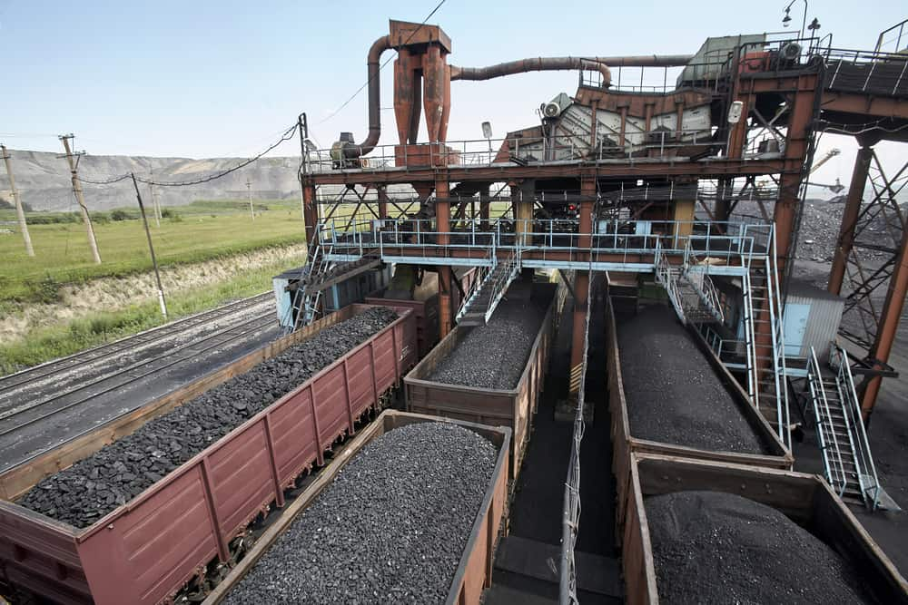



Infra Advisors Sector Coverage
Vipin Verma has more than two decades of experience in banking and financial services covering roles in underwriting, portfolio management, formation and implementation of credit risk policies, sales, credit and collections, as well as IT infrastructure, operations and compliance management.
Affordable Housing
Gati Shakti Cargo Terminal
Waste Management
Food Grain Silos
Transmission

Slide 19
Infra Advisors Achievements

Slide 20

Infra Advisors was adjudged
2nd
in Global Advisors Rankings for Project Finance
by Infralogic in 2022
Marched up from 4th in 2021
Infra Advisors
National Action – Global Footprint

Slide 21
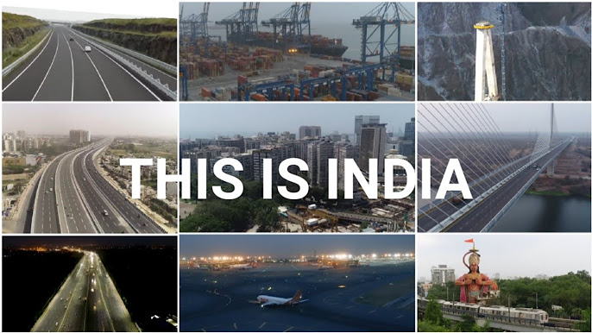
Infra Advisors have completed
Pre-Bid Advisory of 300+ Projects
with Project Cost of over
₹ 2,50,000+ Crores

Slide 22
Infra Advisors have done
Total Debt Arrangement
of
₹ 50,000+ Crores

Slide 23
Infra Advisors Clienteles

Slide 24






Clients – Government Sector-Infra
Government Sector Clienteles

Slide 25










Private Sector Clienteles
www.infragroup.co.in
Empowering Decision with Knowledge ®

Slide 26










Private Sector Clienteles
Empowering Decision with Knowledge ®

Slide 27










Private Sector Clienteles
Empowering Decision with Knowledge ®

Slide 28



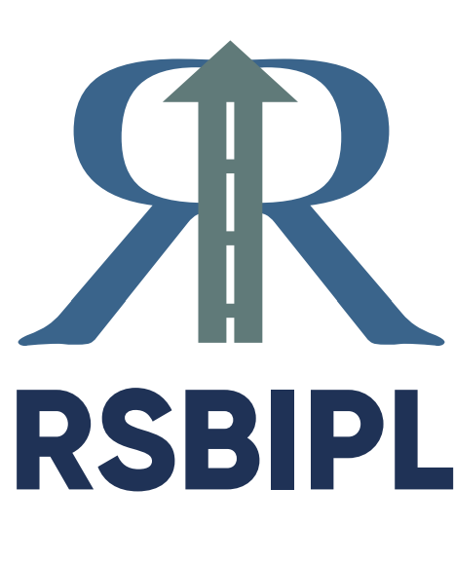






Private Sector Clienteles
Empowering Decision with Knowledge ®

Slide 29










Private Sector Clienteles
Empowering Decision with Knowledge ®

Slide 30
Result Oriented Approach
Infra Advisors brings to you decade+ experience and insight on diverse facets of infrastructure creation.
Infra Advisors empowers you to make well-informed foray in the Infrastructure sector, helping you to be “cautiously aggressive”.
Customised & Result Oriented Solutions

Slide 31


Thank You
Infrastructure Advisors Private Limited
IAPL-kw Capital Advisors LLP
Mumbai | Delhi | Kolkata | Hyderabad | Jaipur | Ahmedabad
Connect us at:
contact@infragroup.co.in

